Slide 1
Norbu Stress Control
CR analysis

Slide 2
Norbu - Introduction
Norbu Stress Control is the first anti-stress app that teaches to manage stress and emotions on the physical level.
It has anxiety relief games, breathing exercises and guided meditations that help to develop stress-control habits. “5-days unlock Premium for free” feature makes these premium exercises available for those who really need them for no cost.
Norbu app has guided meditations and antistress trainings. The exercises are very simple and safe. Anyone can do it. You can meditate and breathe with a guide or in silence.
Great app that helps to manage stress more effectively with exercises that are simple and safe.

Slide 3
Current problem
Low CR in payment.
On a high level , analysing the various factors contributing to the low conversion rate in terms of payment
and thereby deriving “ What is the best mechanism (tariff schema) for switching from the free version to paid one to make it convenient for the user, and at the same time increase the payment or increase the duration of use of free version? “

Slide 4
Questions
To be more precise , these are the questions we need to get the answers to:
How does the cost affect returns of clients?
What may increase retention rate?
What are the optimal prices for optimal retention?
Are there any target audiences that we are missing?

Slide 5
Steps
Considering the size of the data , March 4,2022 to Apr 4,2022 data is used for most of our analysis..
Approach / Steps:
1.Study the retention rates(first_open)
2.Study the session details.
3.Analyse the in-app purchase data and find the pattern users exibit and understand the conversion rate.
4.Coming up with suggestion based on the findings.

Slide 6
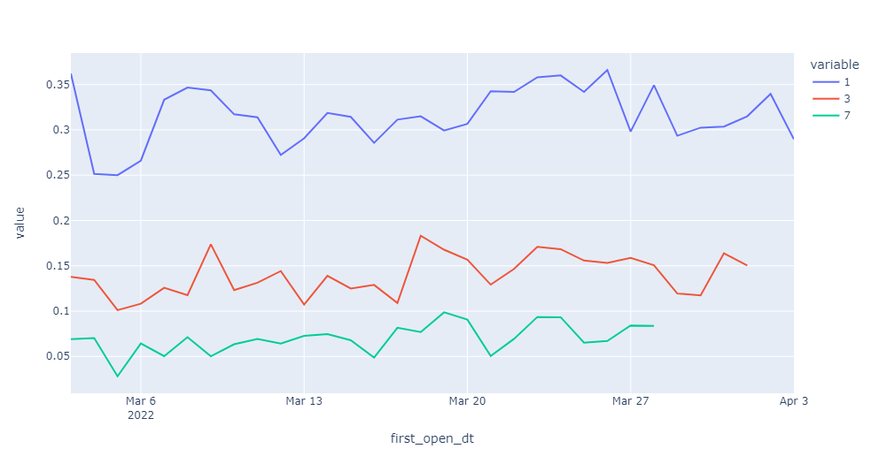
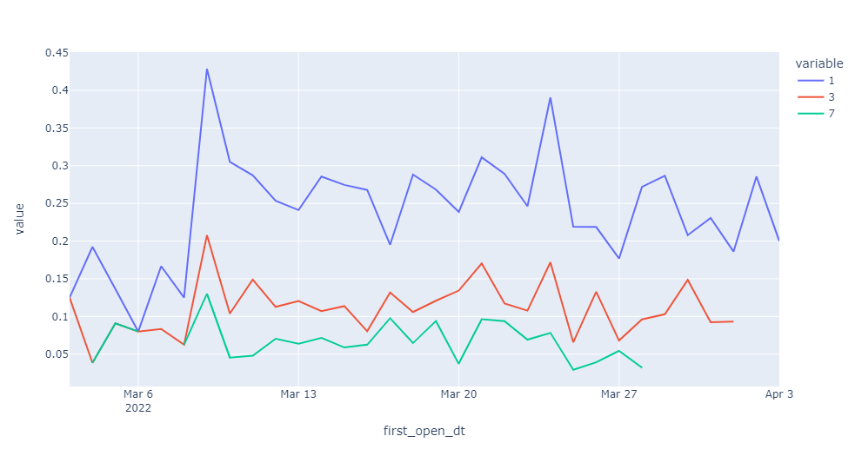
1,3,7 day retention rate - first open
ANDROID
IOS

Slide 7
1,3,7 day retention rate - first open
Though IOS retention has some spikes at some point ,
in general it is lower than Android retention rate.
3 day and 7 day retention of Android users shows some decline .7day retention which is around 7% can be improved . For a non-gaming app , these retention rates though not in the higher side , seems to be fair.

Slide 8
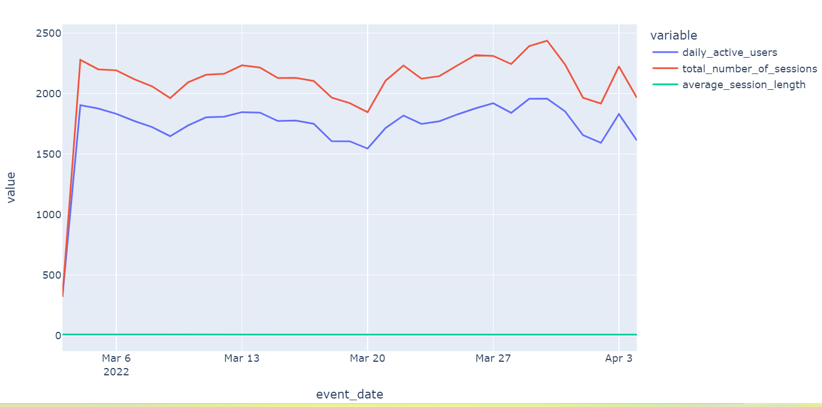
Session details

Slide 9
Session details
The average session length is around 7-8minutes consistently for most of the sessions..
Daily Active Users and total number of sessions shows that most of the users have only 1 session per day .
As stress control is the main objective here ,increased session length will help with effective results.

Slide 10
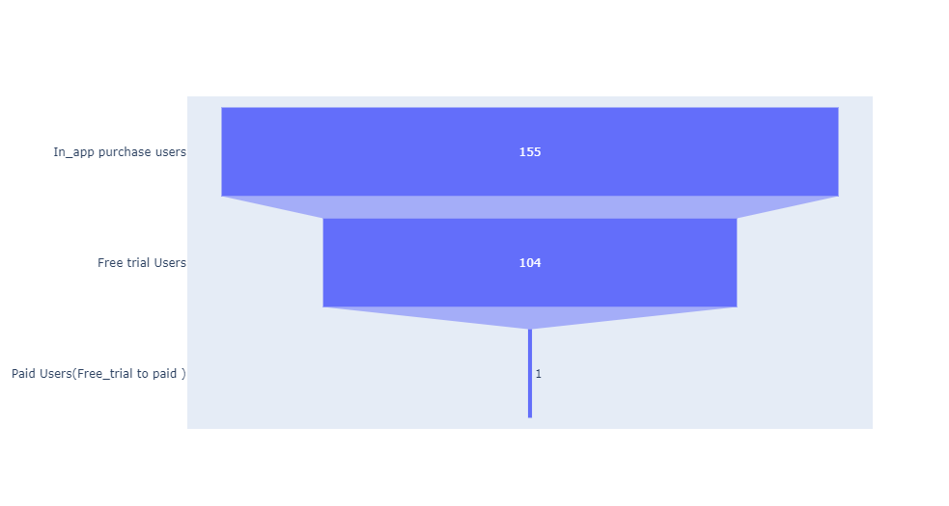
In-App Purchase Event Funnel

Slide 11
In-App Purchase - Event Funnel
Around 11% of the total in_app purchase users opt for free trial.
Looking at the users in free trial , only 1 user (less than 1% )go for paid subscription..
Based on all the above data , it is very clear that we have
a very low conversion rate.

Slide 12
Users in free trial
About 67% of the users with in_app purchase are in free_trial ..
More than 60% of the users have used just 2-3 days in a
month in their free trial period.
All the users we have in this free trial are from IOS platform using the product ‘norbu_annual_ios’
Only one user goes for paid subscription buying the product ‘app.norbu.premium_sale’ of original value 29.99 on sale with value of 17.99usd.

Slide 13
Paid users
Only 1% of the users convert from free trial to paid
subscription.
Around 33% of the users in in_app purchases are paid
users where only 1 user is converted to paid from free
trial.
Since we don’t have enough data with paid subscription
from free trial to proceed our analysis , we try to derive conclusions from the customers who already have paid subscription .

Slide 14
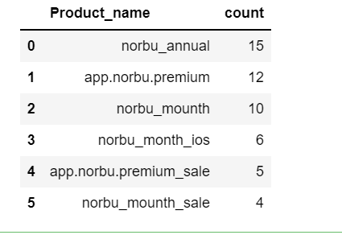
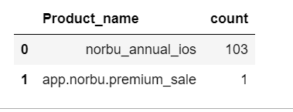
Free trial vs paid users
Free User
Paid User

Slide 15
Paid Users
‘norbu_annual’ ,’app.norbu.premium’,’norbu_mounth’, ‘norbu_month_ios’,’app.norbu.premium_sale’,’norbu_mounth_sale’ are the products bought by paid subscription.
Though in pricy side ,’app.norbu.premium’ is bought by more users for 30$ as well as few on sale for 15-20$.
‘norbu_month’ which is on lower pricing(3-5$)is bought by few users especially in IOS platform.

Slide 16
Paid Users
To sum up , with more users buying ‘app.norbu_premium’,
we see that cost doesn’t affect the clients much.
‘app.norbu_premium’ can be offered with some sale (15-20$) and also with more added features / upgrades .
Also ‘norbu_month’ can be upgraded and promoted with the same price range with added features.

Slide 17
Conclusion with Answers
Since increased number of users buy pricier 'app.norbu.premium', we see that cost doesn’t affect the return of clients.
Since users are not fully using free trial period, detailed analysis should be made on free_trial users regarding the factors preventing users from fully using free_trial period.

Slide 18
Conclusion with Answers
'app.norbu.premium' is the product bought by more users though it is pricier.(20-30) and also when sales(15-20 )
To attract more users , we can offer more added features in 'app.norbu.premium' in the price range (15-20$) especially for ANDROID users.
'norbu_month' can be promoted by increasing the features available within the same price range(3-5$).

Slide 19
Conclusion with Answers
With less active users in free trial ,we won’t see major impact with increased free trial duration .
It’s better to go with increased price rather than increased free trial duration.
With this dataset , we miss valuable data about Android users to support our analysis .
Making all these changes will positively impact retention rate and conversion rate in the future..

Slide 20
THE END

